Slide 1
Week 26
Monday, March 10th , 2006

Slide 2

REVIEW 3
LESSON 1

Slide 3
Table of contents
01
02
03
WARM UP
LISTEN AND CHOOSE
ASK AND ANSWER

Slide 4
01
WARM UP

Slide 5
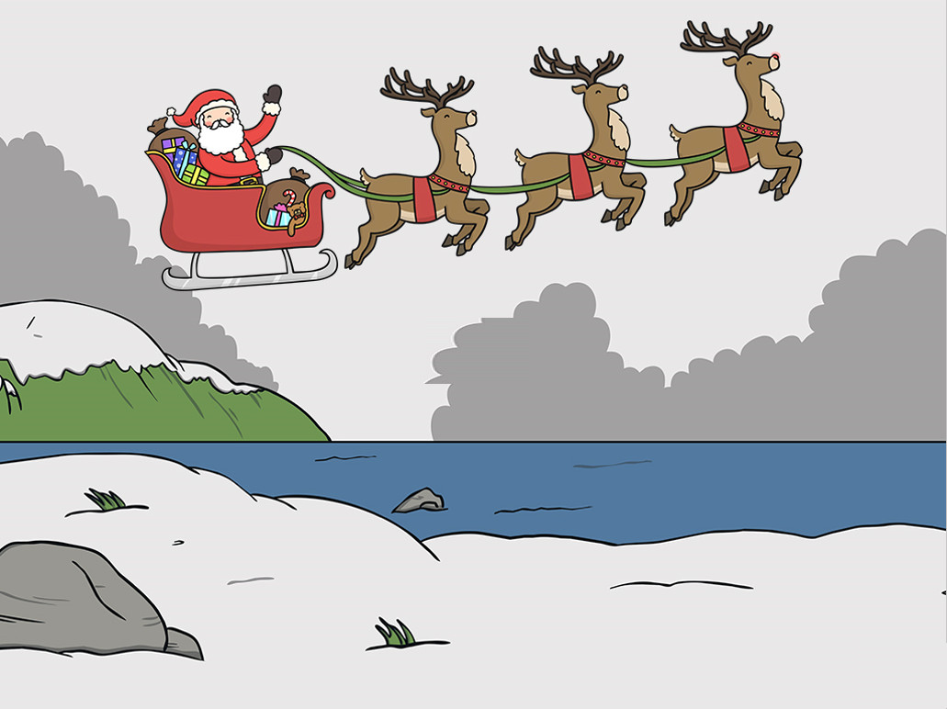
Help Santa Claus

Slide 6
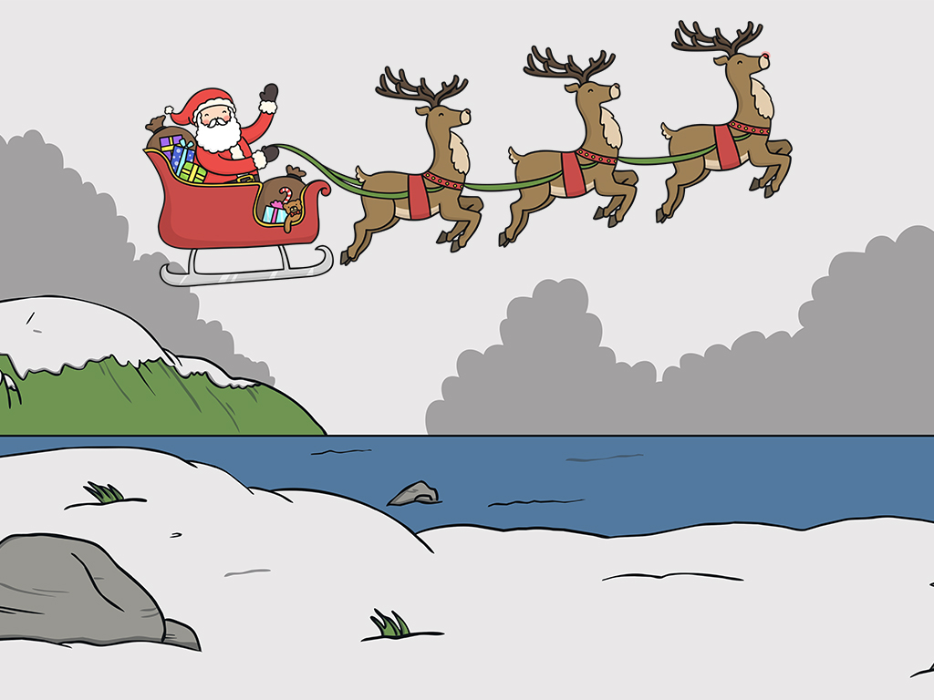
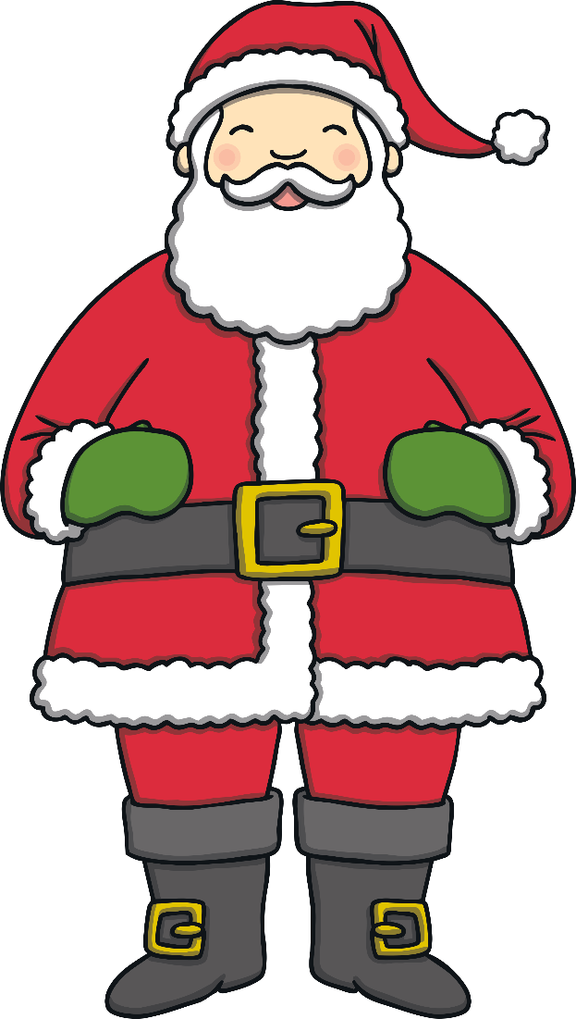
Ho, ho, hello children!
Some Christmas presents have fallen Can you help me collect them ?
Click ‘check’ to see if you are right.
Can you help me collect all the presents?

Slide 7


Where does she live ?
She ......in Tiger Town.
a.
live
b. living
c.
lives
Click the check button to reveal the answer.
Check

Slide 8


When do you......?
At noon
a. play game
b. watch TV
c. listen to music
Click the check button to reveal the answer.
Check

Slide 9
Where do you live ?
I live.......35 Green Street
a. in
b. at
c. on
Click the check button to reveal the answer.
Check

Slide 10
.....does your mother do ?
She’s a farmer
a. What
b. Where
c. Who
Click the check button to reveal the answer.
Check

Slide 11
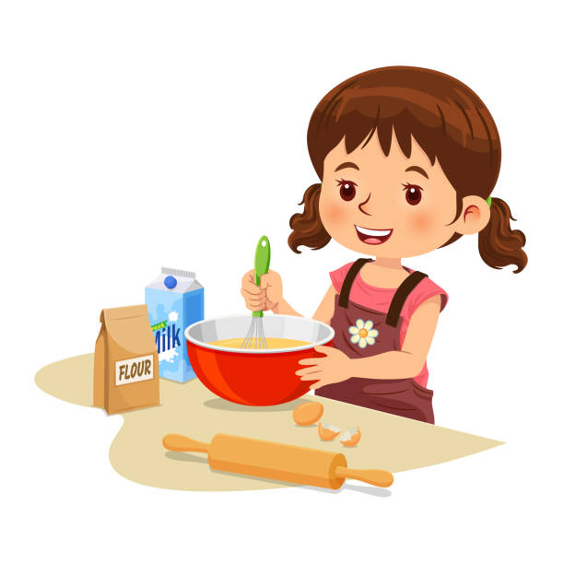

What do you do in the afternoon ?
I help my mum with the.....
a. cooking
b. eating
c. washing
Click the check button to reveal the answer.
Check

Slide 12
a. What are you doing ?
b. Where does your brother go on Sundays ?
c. Where is your brother going ?
Click the check button to reveal the answer.
Check

Slide 13

Where is your mother on Sundays ?
.............
a. She is thin and short.
b. She’s at home
c. She cooks meals
Click the check button to reveal the answer.
Check

Slide 14
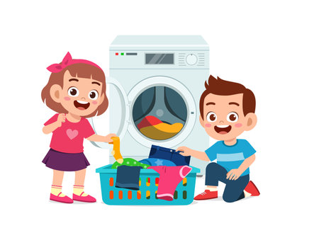
a. homework
b. clean
c. wash clothes
Click the check button to reveal the answer.
Check

Slide 15
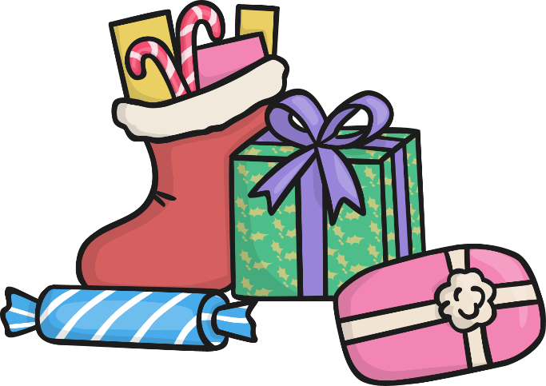
Well Done!
You found all of the missing presents. Thank you for your help!
Click the presents to return to the beginning of the presentation.

Slide 16
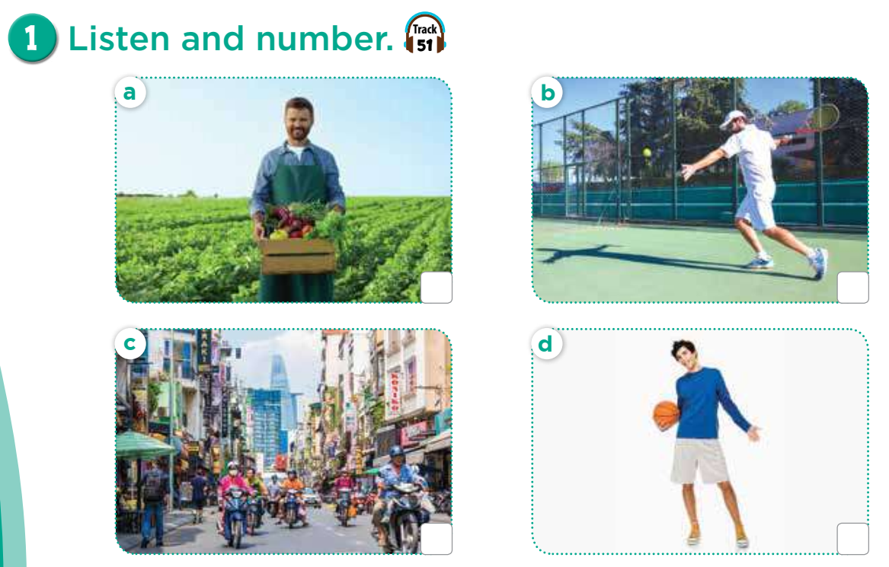


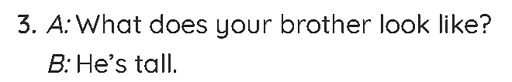
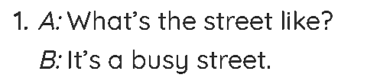
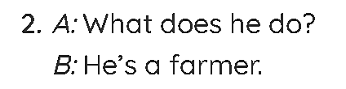
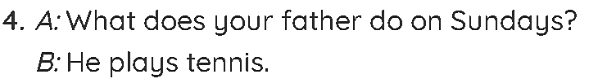
2
4
1
3

Slide 17
ASK AND ANSWER
03

Slide 18
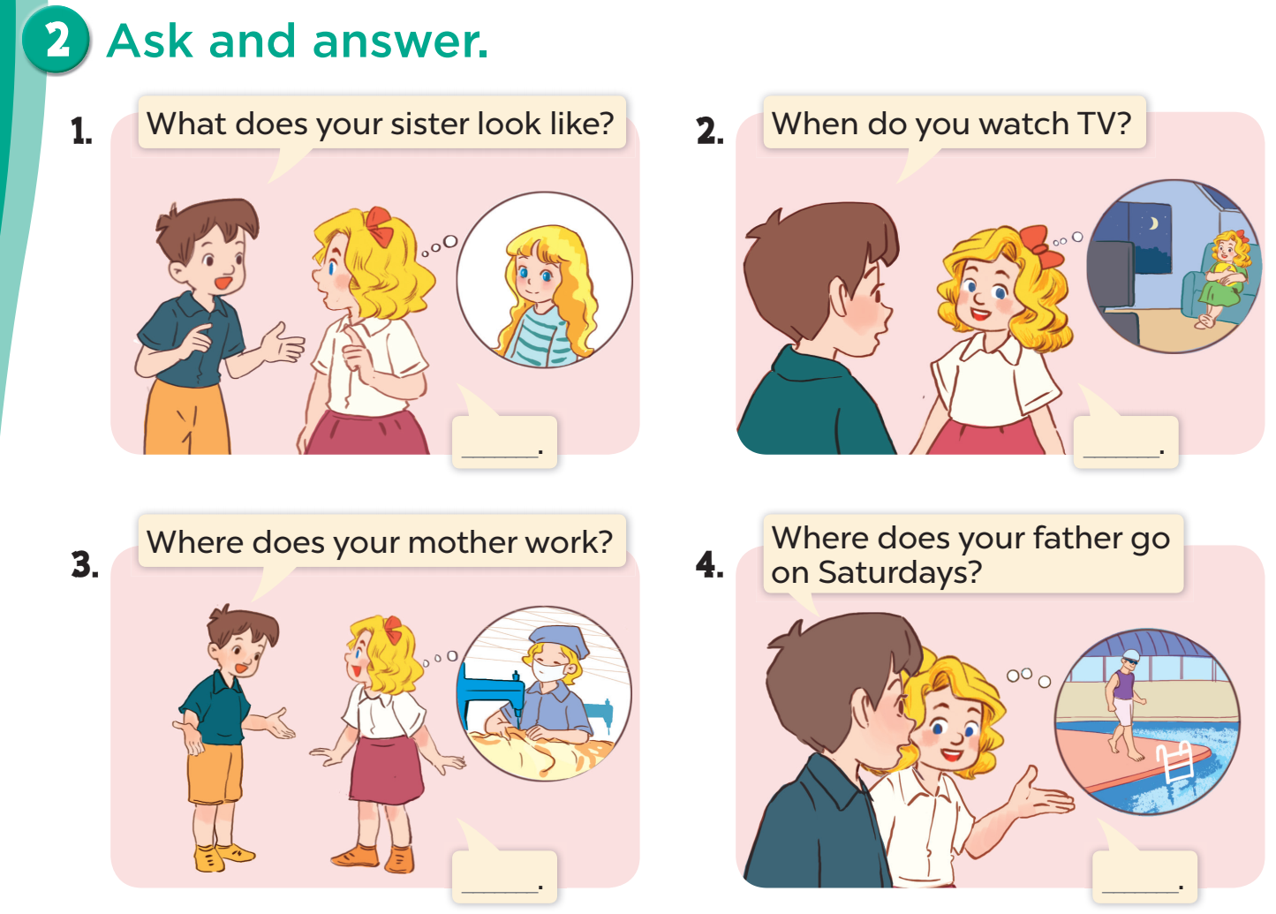

Slide 19
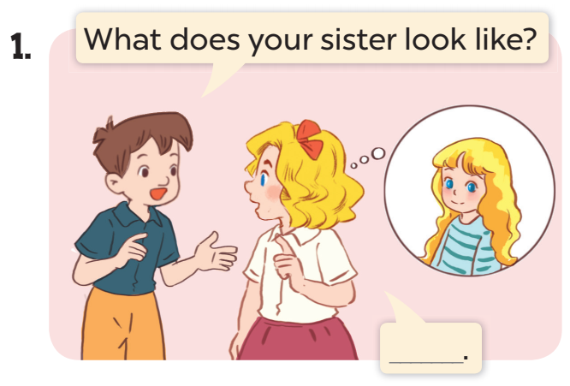
She has long hair.

Slide 20
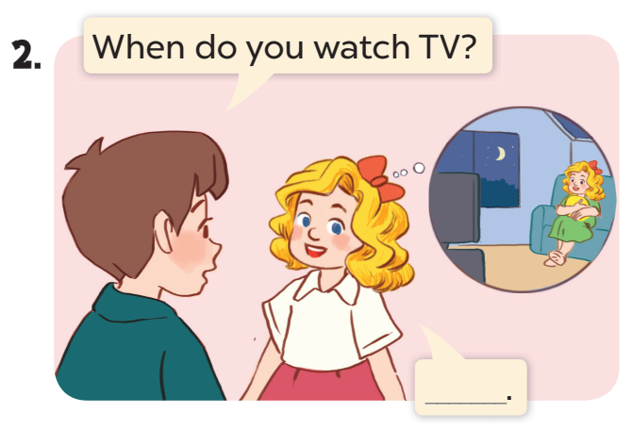
I watch TV in the evening.

Slide 21
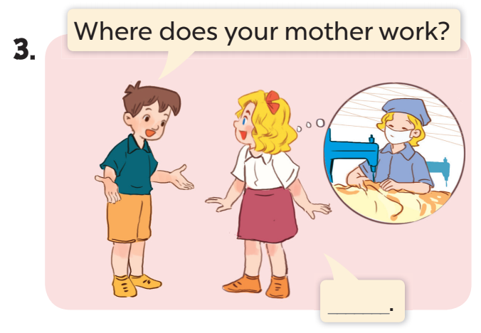
She works at a factory.

Slide 22
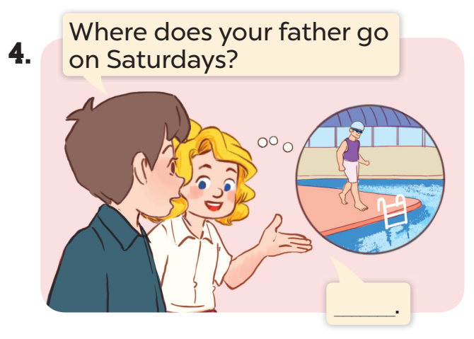
He goes to the
swimming pool.

Slide 23
https://giaoviendoimoi.com/join? code=66383

Slide 24
GOOD BYE

