Slide 1





Unit 15
OUR
HEALTH
Lesson 2 – Period 3

Slide 2









Table of Contents
Warm-up and Review
Activity 1: Look, listen and repeat.
Activity 2: Listen, point and say.
Activity 3: Let’s talk.
Fun corner and Wrap-up

Slide 3

01
Warm-up and Review

Slide 4



Lucky
Gift
Boxes
Let’s open them!

Slide 5







Notes:
Click the gift box to link to the Question slide.
Click the opened box to end to game.

Slide 6


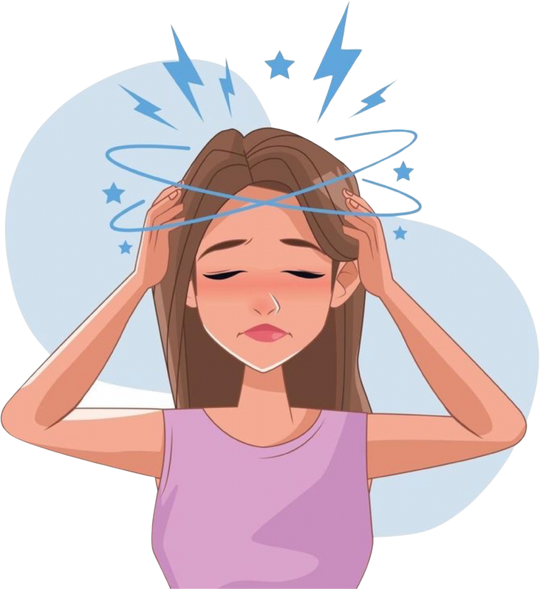
What’s the matter?
I have a headache.
Notes:
Click the flower next to the answer to back to the Gift boxes slide.

Slide 7

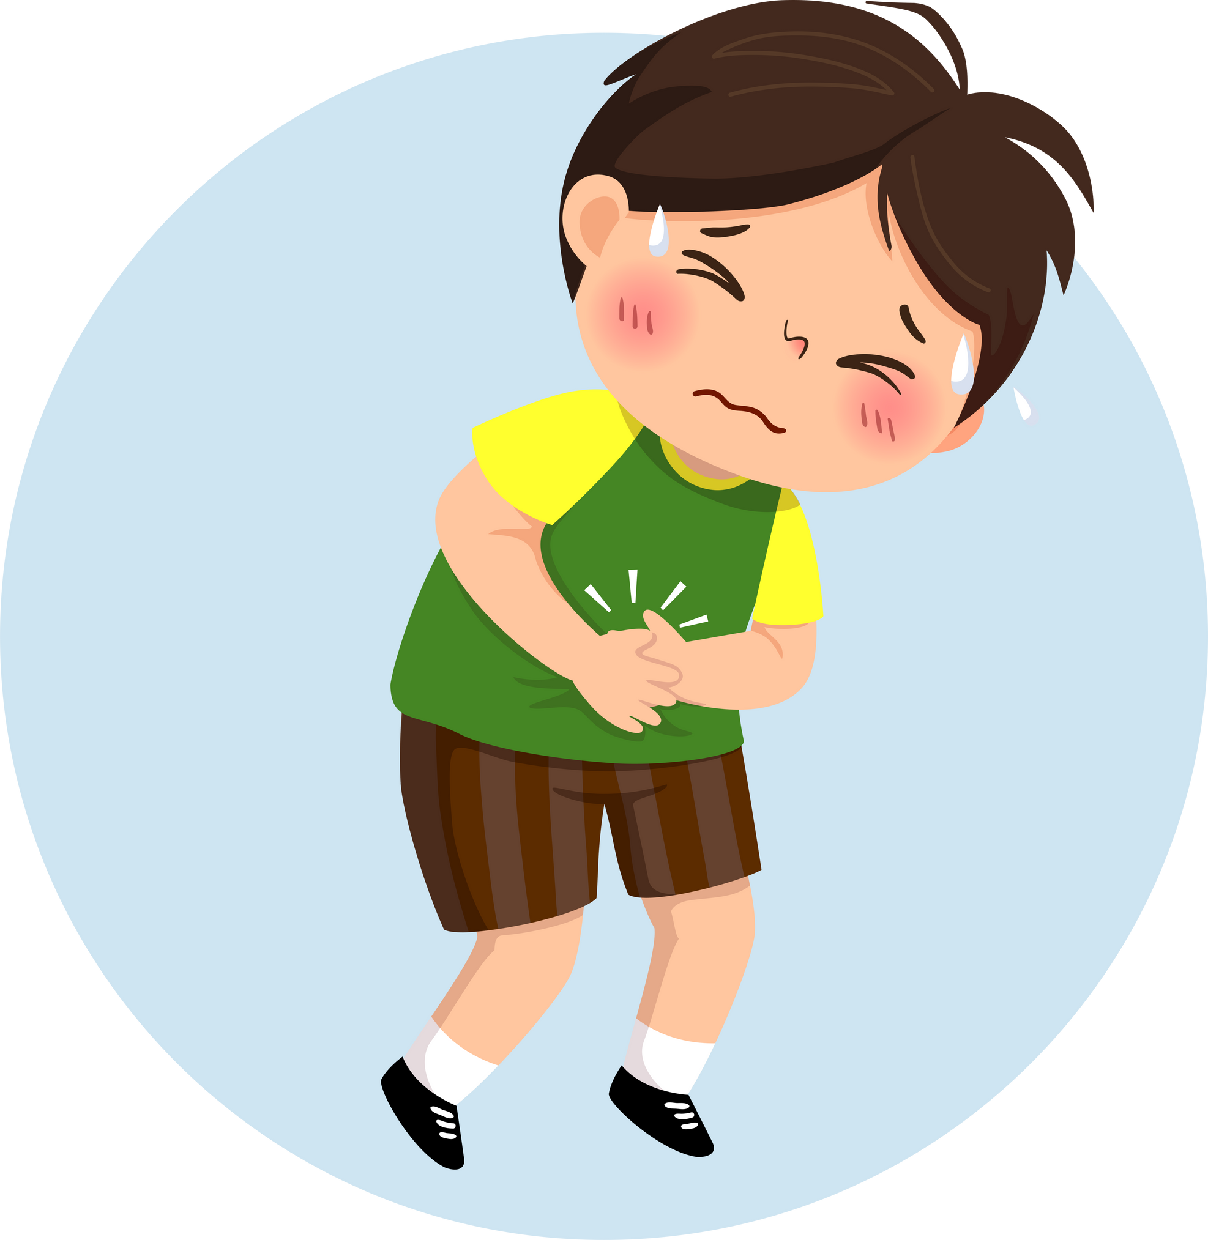
What’s the matter?
I have a stomach ache.
Notes:
Click the flower next to the answer to back to the Gift boxes slide.

Slide 8
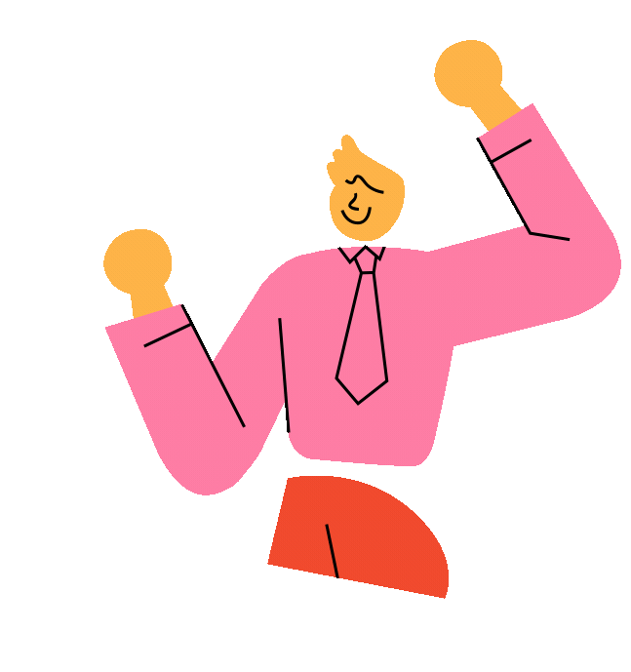
double scores!
Notes:
Click the flower next to the answer to back to the Gift boxes slide.

Slide 9
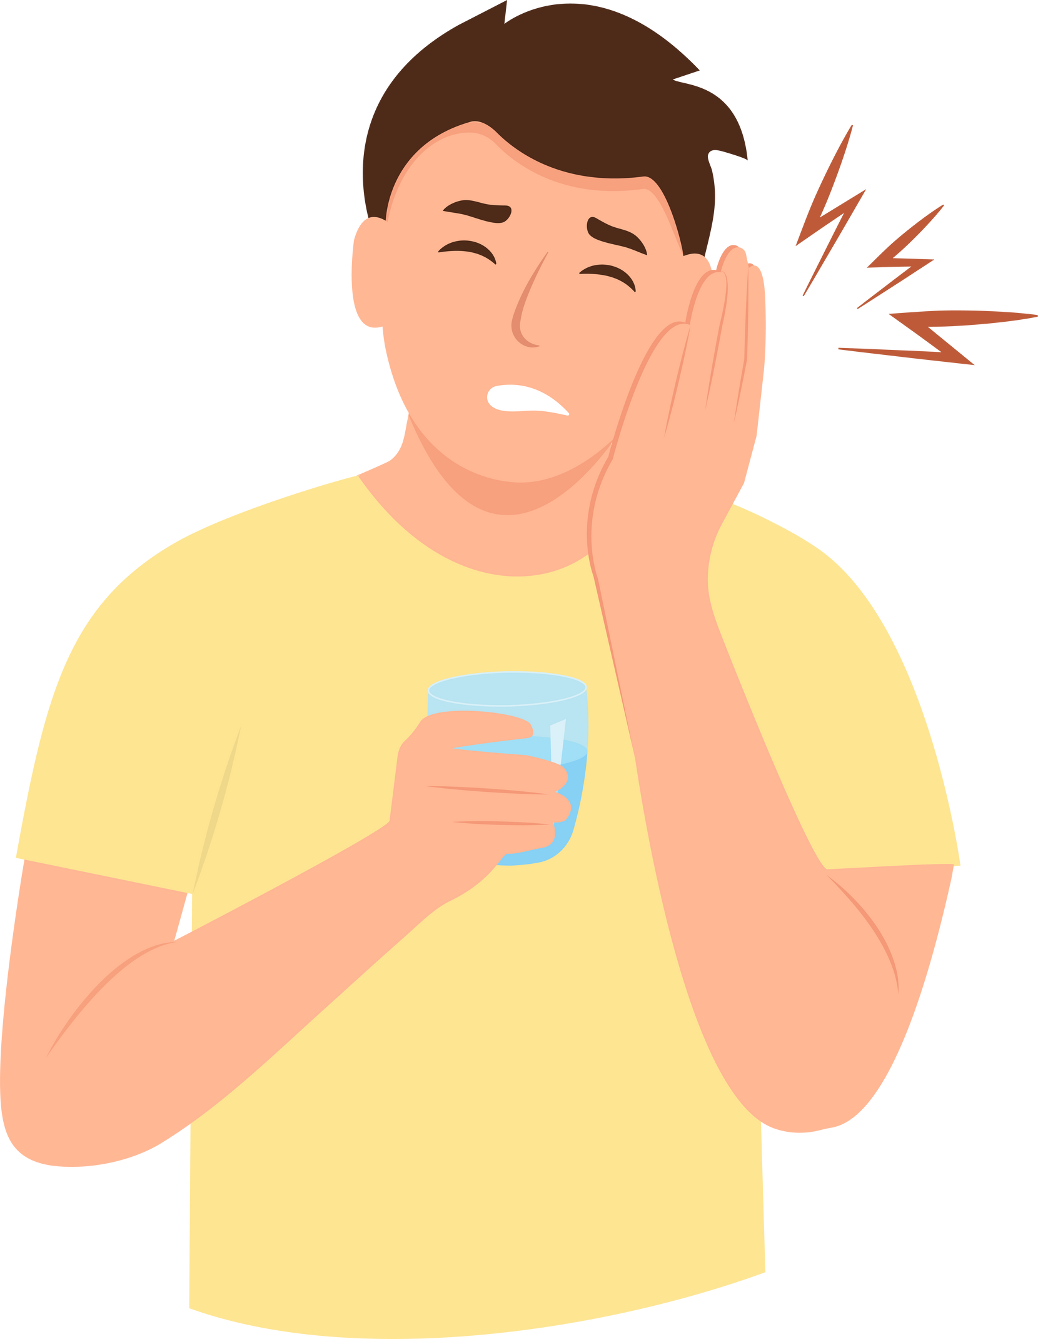
What’s the matter?
I have a toothache.
Notes:
Click the flower next to the answer to back to the Gift boxes slide.

Slide 10

Notes:
Click the flower next to the answer to back to the Gift boxes slide.

Slide 11


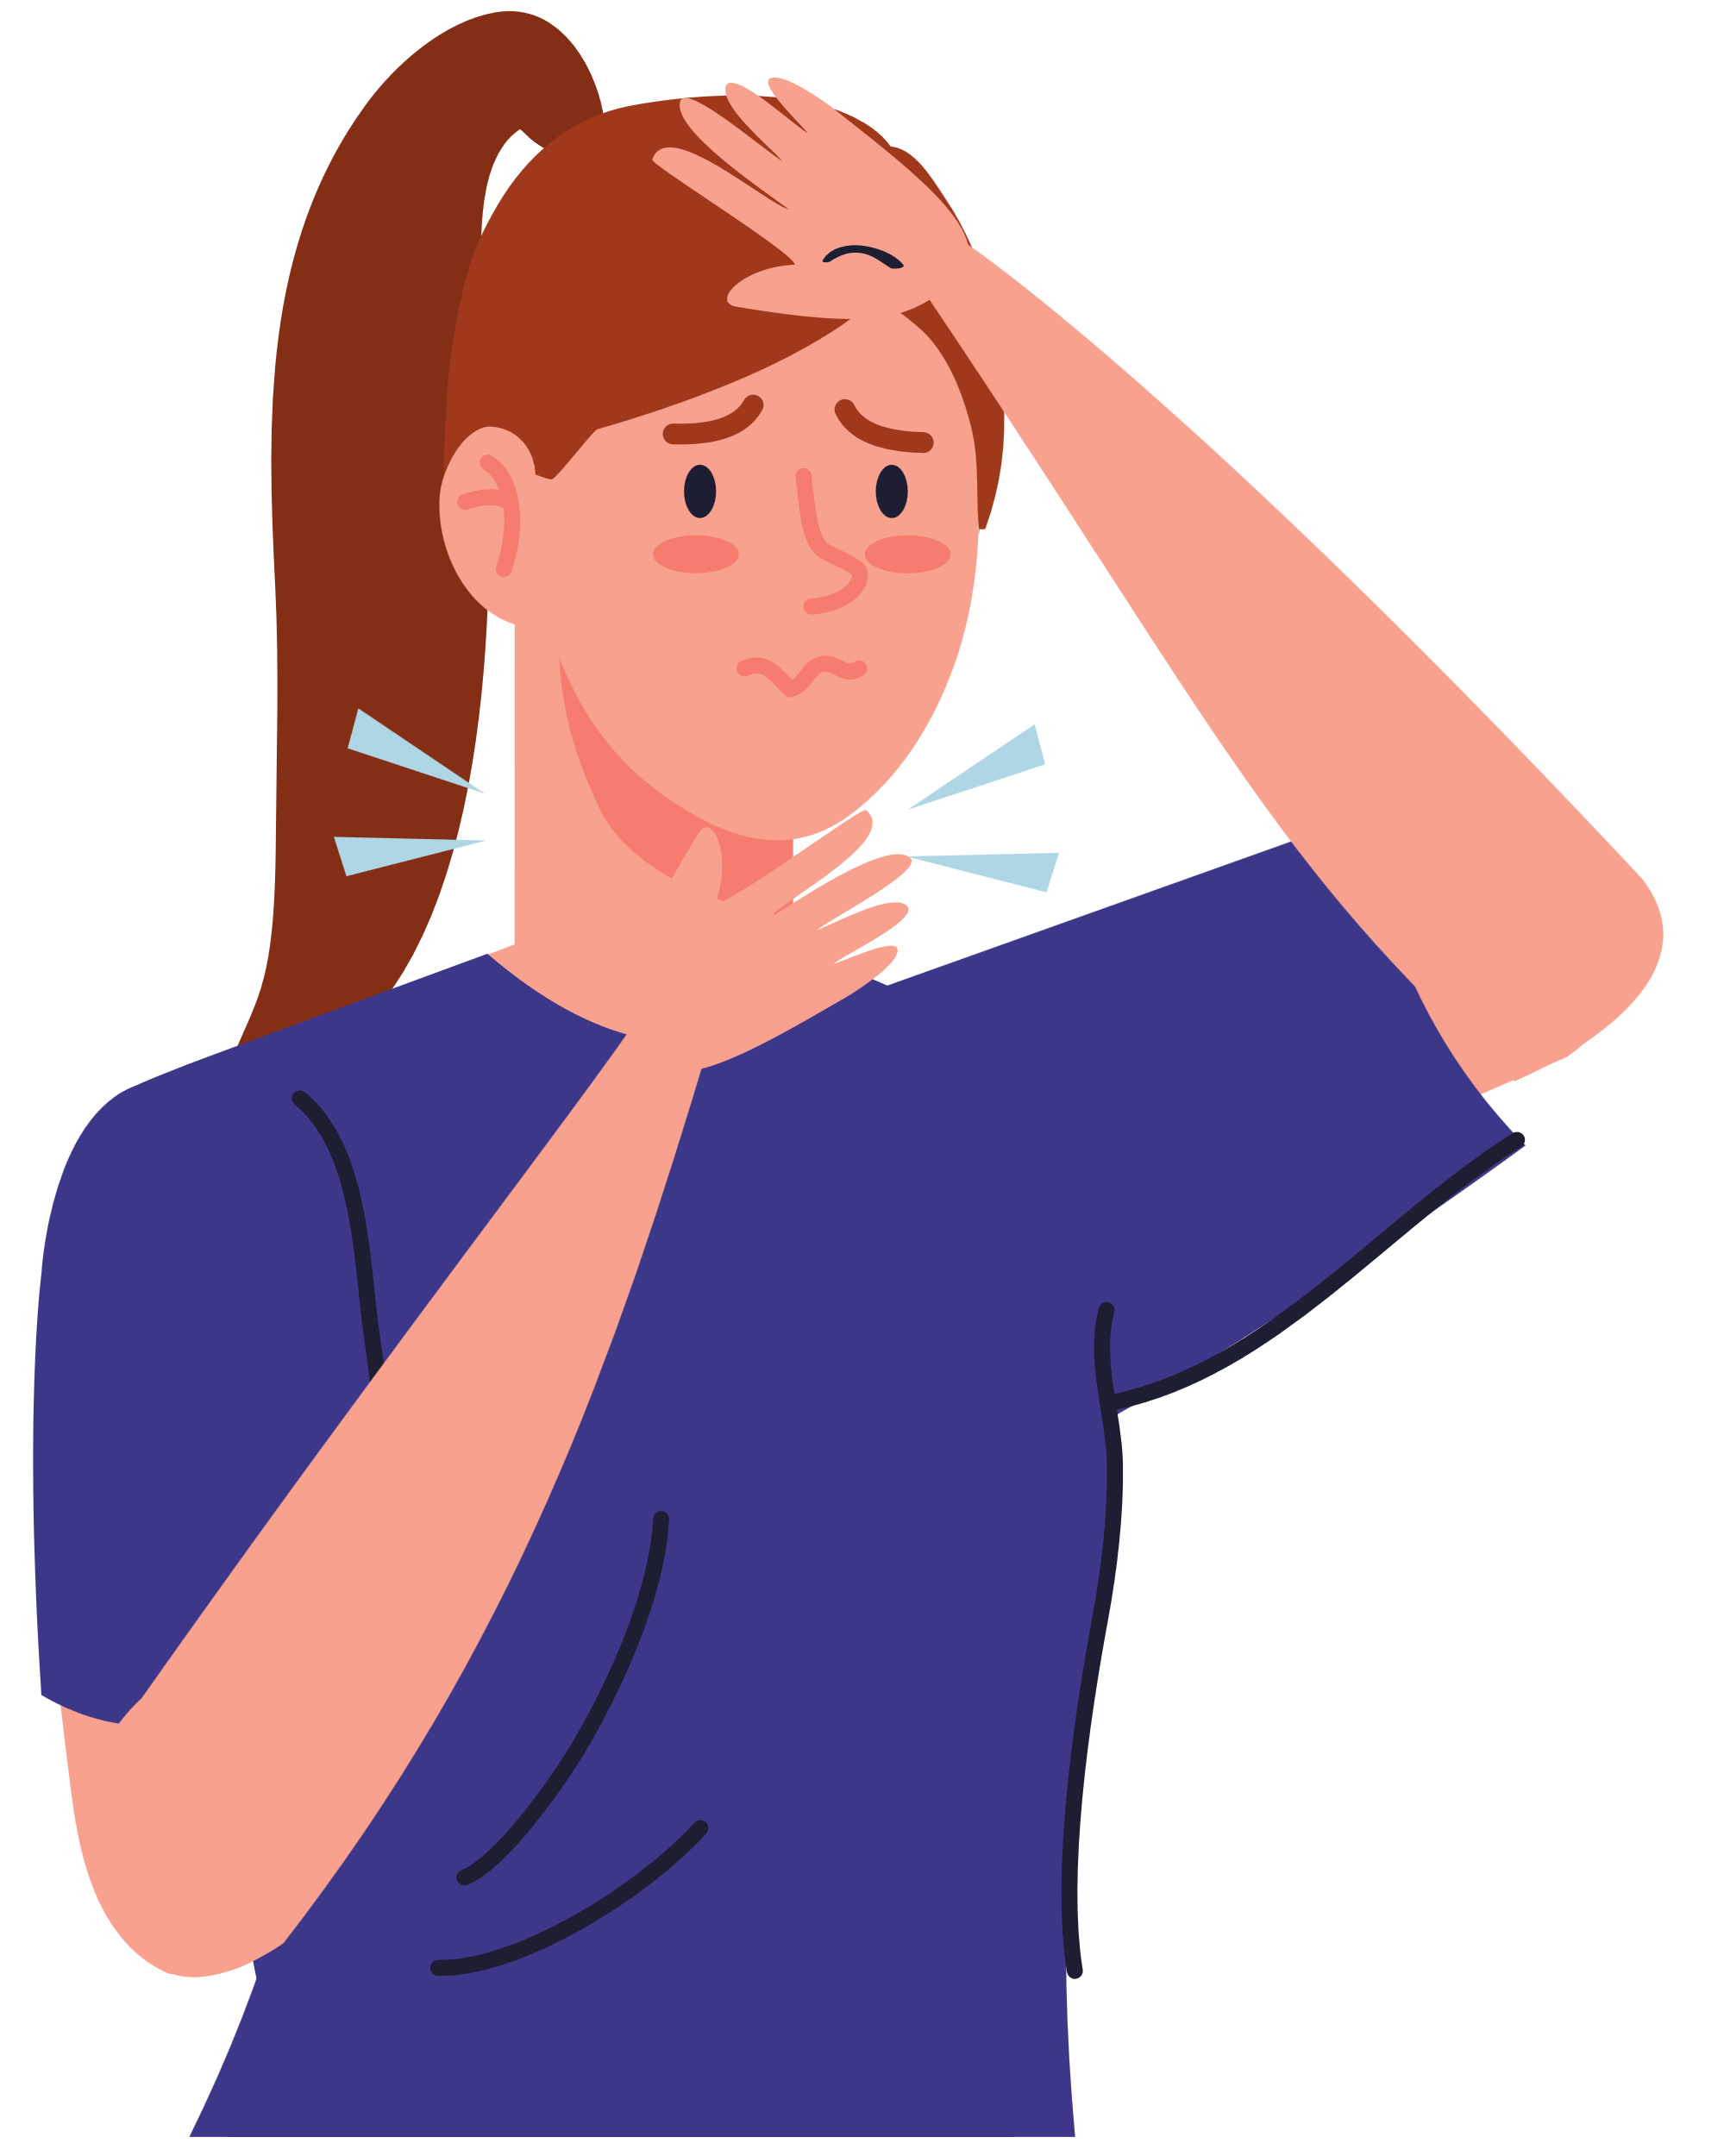
What’s the matter?
I have
a sore throat.
Notes:
Click the flower next to the answer to back to the Gift boxes slide.

Slide 12





Slide 13
VOCABULARY

Slide 14
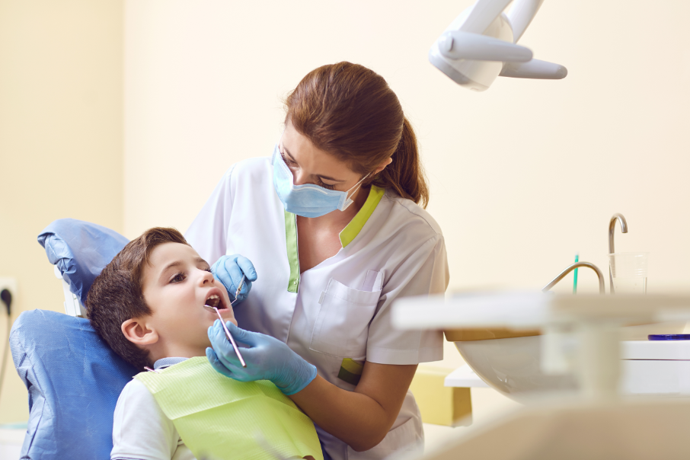
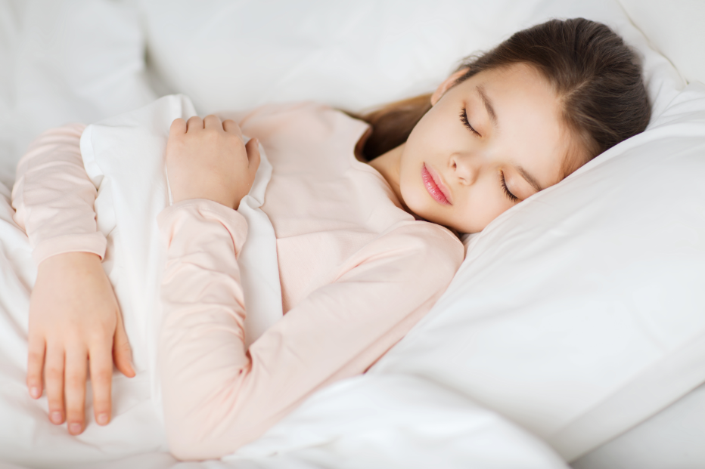
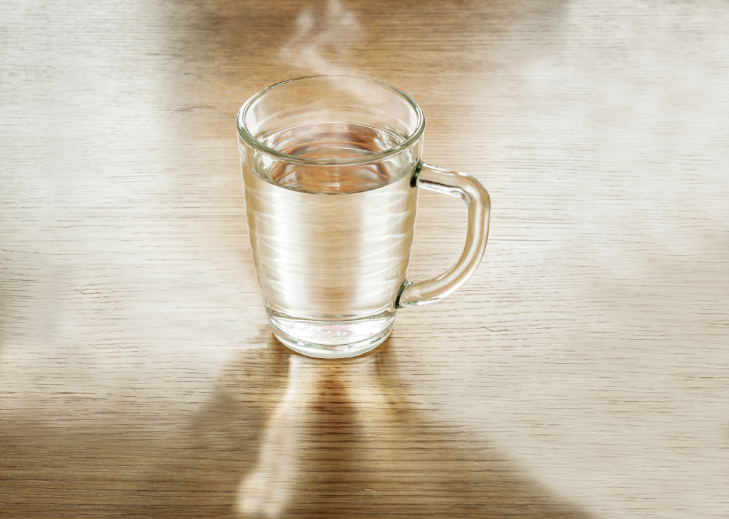
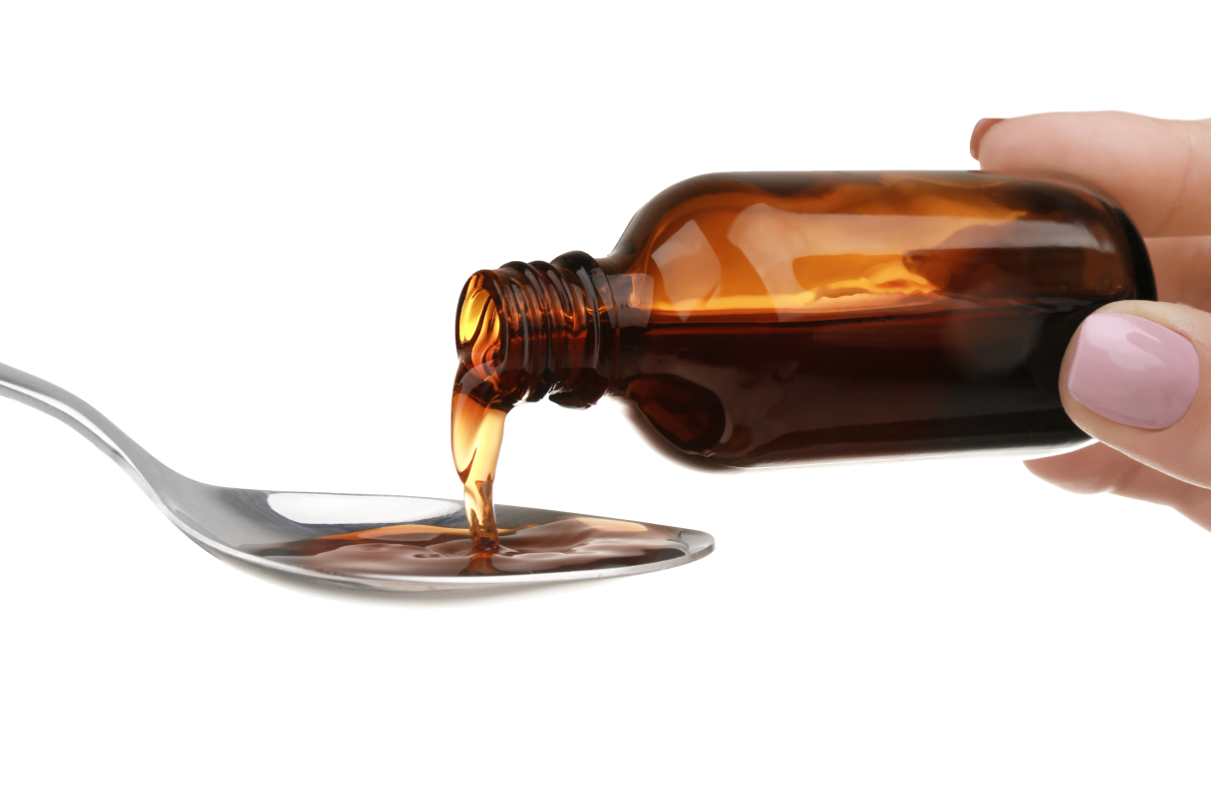
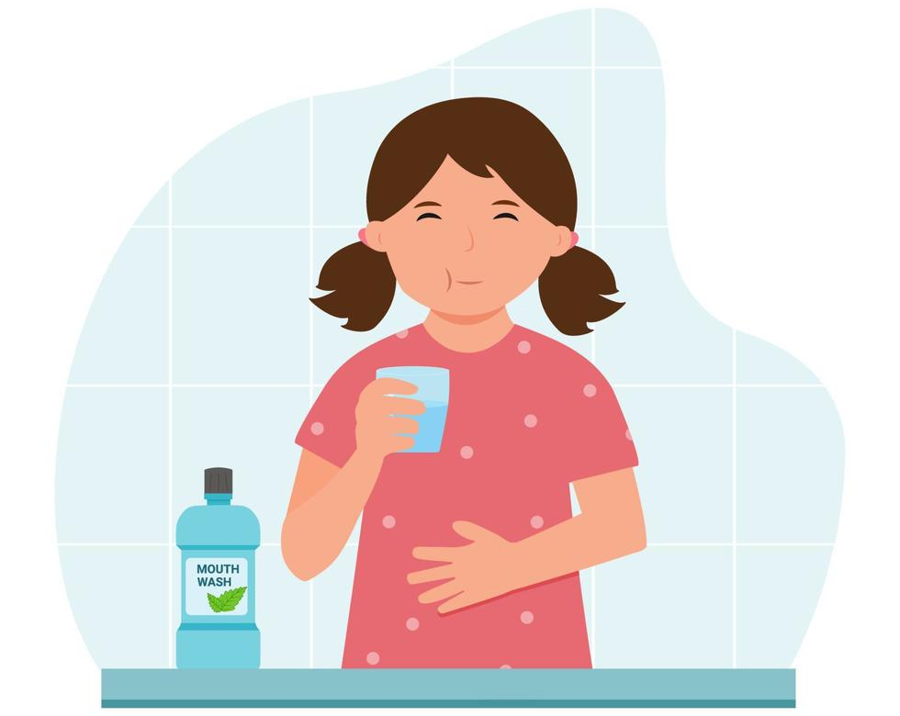

1. go to the dentist
2. have a rest
3. drink warm water
4. take some medicine
5. advice
5. rinse your mouth

Slide 15
02
Activity 1
Look, listen and repeat.

Slide 16

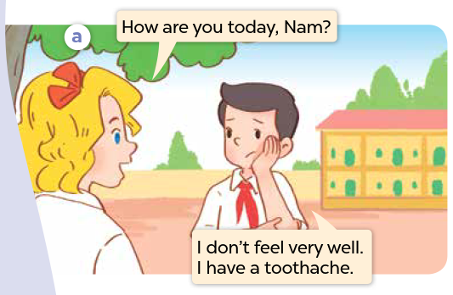
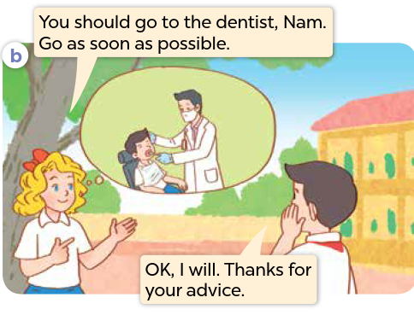

Look and say.
Notes:
Step 1: Ask pupils to look at Pictures a and b, and identify the characters in the pictures. Have them say what they can see in the thought bubbles.

Slide 17

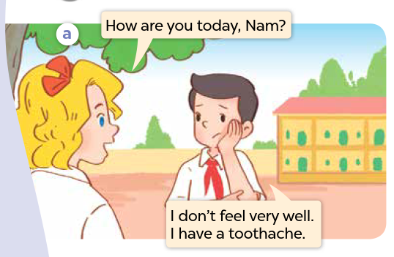
Listen and point.
Notes:
Step 2: Ask pupils to look at Picture a. Play the recording of two exchanges for them to listen to.
Step 3: Play the recording again, sentence by sentence, for pupils to listen and repeat individually and in chorus. Correct their pronunciation where necessary. Repeat the same procedure with Picture b.

Slide 18
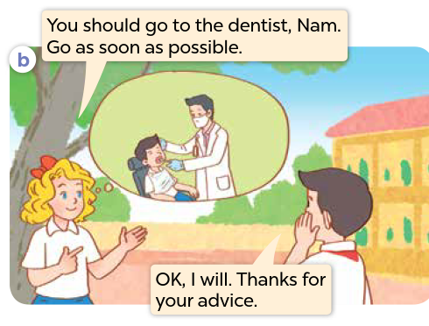
Listen and point.
Notes:
Step 2: Ask pupils to look at Picture a. Play the recording of two exchanges for them to listen to.
Step 3: Play the recording again, sentence by sentence, for pupils to listen and repeat individually and in chorus. Correct their pronunciation where necessary. Repeat the same procedure with Picture b.

Slide 19
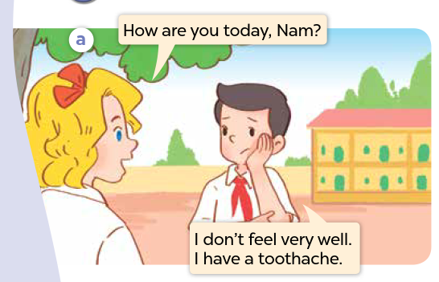
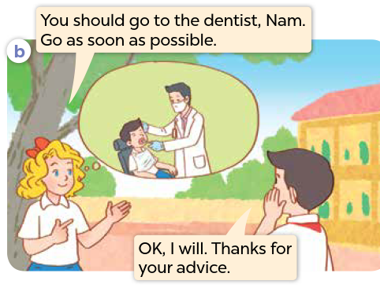
Listen and repeat.
Notes:
Step 4: Invite a few pairs to the front of the class to listen and repeat the sentences in the recording. Give corrections and feedback where necessary.
Step 5: Direct pupils’ attention to the advice You should go to the dentist? and the response Thanks for your advice. Tell pupils that they are advice and a response about health problems.

Slide 21
03
Activity 2
Listen, point and say.

Slide 22

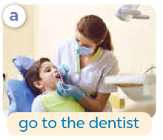
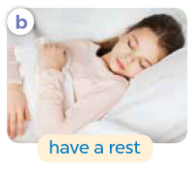
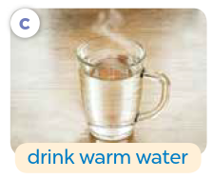
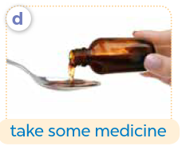
Look and say.
Notes:
Have pupils look at the pictures and say what they can see.

Slide 23
Listen and repeat.
a. go to the dentist
Notes:
Step 1: Have pupils point at Picture a, listen to the recording and repeat the phrase go to the dentist several times. Repeat the same procedure with Pictures b, c and d. Have the class repeat the phrases.

Slide 24
Listen and repeat.
b. have a rest
Notes:
Step 1: Have pupils point at Picture a, listen to the recording and repeat the phrase go to the dentist several times. Repeat the same procedure with Pictures b, c and d. Have the class repeat the phrases.

Slide 25
Listen and repeat.
c. drink warm water
Notes:
Step 1: Have pupils point at Picture a, listen to the recording and repeat the phrase go to the dentist several times. Repeat the same procedure with Pictures b, c and d. Have the class repeat the phrases.

Slide 26
Listen and repeat.
d. take some medicine
Notes:
Step 1: Have pupils point at Picture a, listen to the recording and repeat the phrase go to the dentist several times. Repeat the same procedure with Pictures b, c and d. Have the class repeat the phrases.

Slide 27
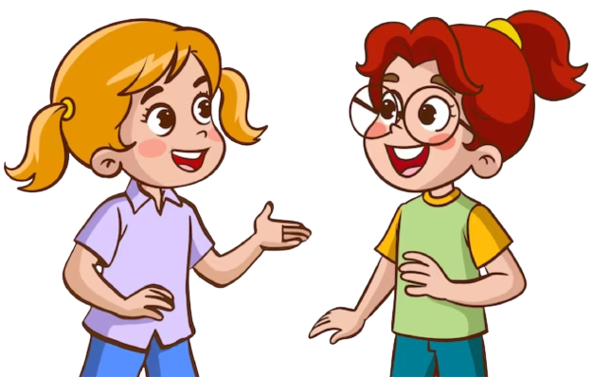
Listen and repeat.
You should …………………..
Thanks for
your advice.
Notes:
Step 2: Point at the advice pattern You should ____. Read it aloud and have pupils repeat it. Follow the same procedure with the response Thanks for your advice.

Slide 28
Listen and repeat.
You should go to the dentist.
Thanks for
your advice.
Notes:
Step 3: Point at Picture a and have pupils listen and repeat after the recording You should go to the dentist. - Thanks for your advice. Repeat the same procedure with Pictures b, c and d.

Slide 29
Listen and repeat.
You should have a rest.
Thanks for
your advice.
Notes:
Step 3: Point at Picture a and have pupils listen and repeat after the recording You should go to the dentist. - Thanks for your advice. Repeat the same procedure with Pictures b, c and d.

Slide 30
Listen and repeat.
You should drink warm water.
Thanks for
your advice.
Notes:
Step 3: Point at Picture a and have pupils listen and repeat after the recording You should go to the dentist. - Thanks for your advice. Repeat the same procedure with Pictures b, c and d.

Slide 31
Listen and repeat.
You should take some medicine.
Thanks for
your advice.
Notes:
Step 3: Point at Picture a and have pupils listen and repeat after the recording You should go to the dentist. - Thanks for your advice. Repeat the same procedure with Pictures b, c and d.

Slide 32



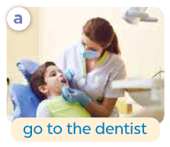
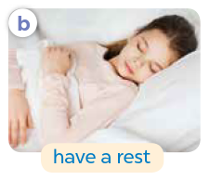

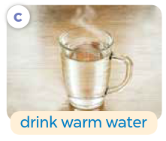
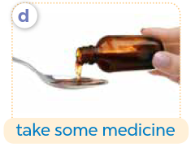
Look and say.
Notes:
Step 4: Divide the class into two groups to take turns repeating the advice and the responses for Pictures a - d until they feel confident.

Slide 33
Work in pairs.
Notes:
Step 5: Have pairs of pupils practise advising and responding to the advice with the pictures. Invite a few pairs to point at the pictures and say the questions and the answers in front of the class. Check their pronunciation, give corrections and feedback where necessary.

Slide 35
04
Activity 3
Let’s talk.

Slide 36
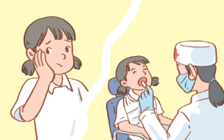
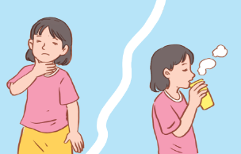
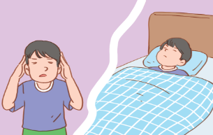
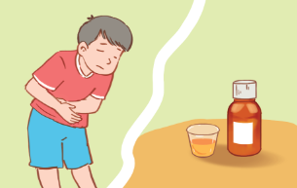
What’s the matter?
Look and say.
You should …….
………………
……………………..
Notes:
Step 1: Draw pupils’ attention to the pictures and guess the health problems that the characters have. Read the advice in the first speech bubble aloud and ask pupils to repeat it. Ask pupils to look at the second bubble and identify what the answer should be.

Slide 37

Look and say.
What’s the matter?
You should ……….
________.
Thanks for
your advice.
Notes:
Step 2: Have pairs of pupils practise advising and responding to the advice about health problems. Go around the class and provide support when necessary.

Slide 38
Look and say.
What’s the matter?
You should drink warm water.
I have a sore throat.
Thanks for
your advice.
Notes:
Step 3: Invite a few pairs to practise advising and responding to the advice about health problems. Give corrections and feedback where necessary.

Slide 39
Look and say.
What’s the matter?
You should take some medicine.
Thanks for
your advice.
I have a stomach ache.
Notes:
Step 3: Invite a few pairs to practise advising and responding to the advice about health problems. Give corrections and feedback where necessary.

Slide 40
Look and say.
What’s the matter?
You should go to the dentist.
Thanks for
your advice.
I have a toothache.
Notes:
Step 3: Invite a few pairs to practise advising and responding to the advice about health problems. Give corrections and feedback where necessary.

Slide 41
Look and say.
What’s the matter?
You should have a rest.
Thanks for
your advice.
I have a headache.
Notes:
Step 3: Invite a few pairs to practise advising and responding to the advice about health problems. Give corrections and feedback where necessary.

Slide 43
05
Fun corner and Wrap-up

Slide 44





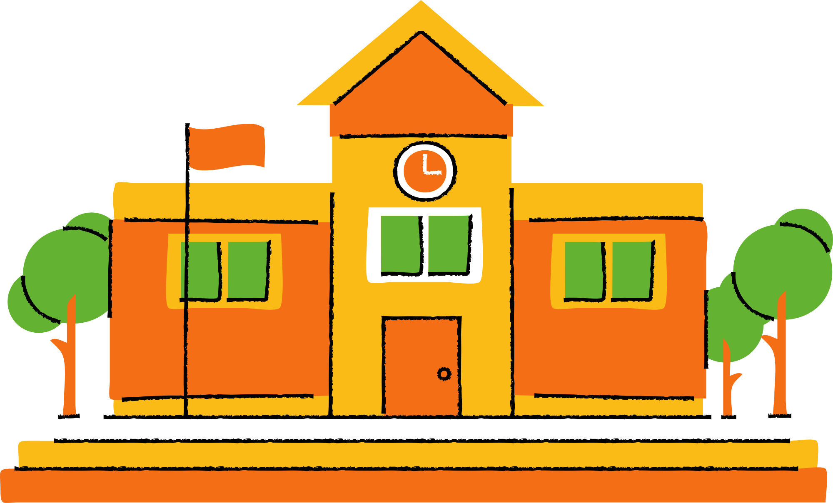
QUIZ TIME
Let's Put Your Knowledge to The Test!

Slide 45




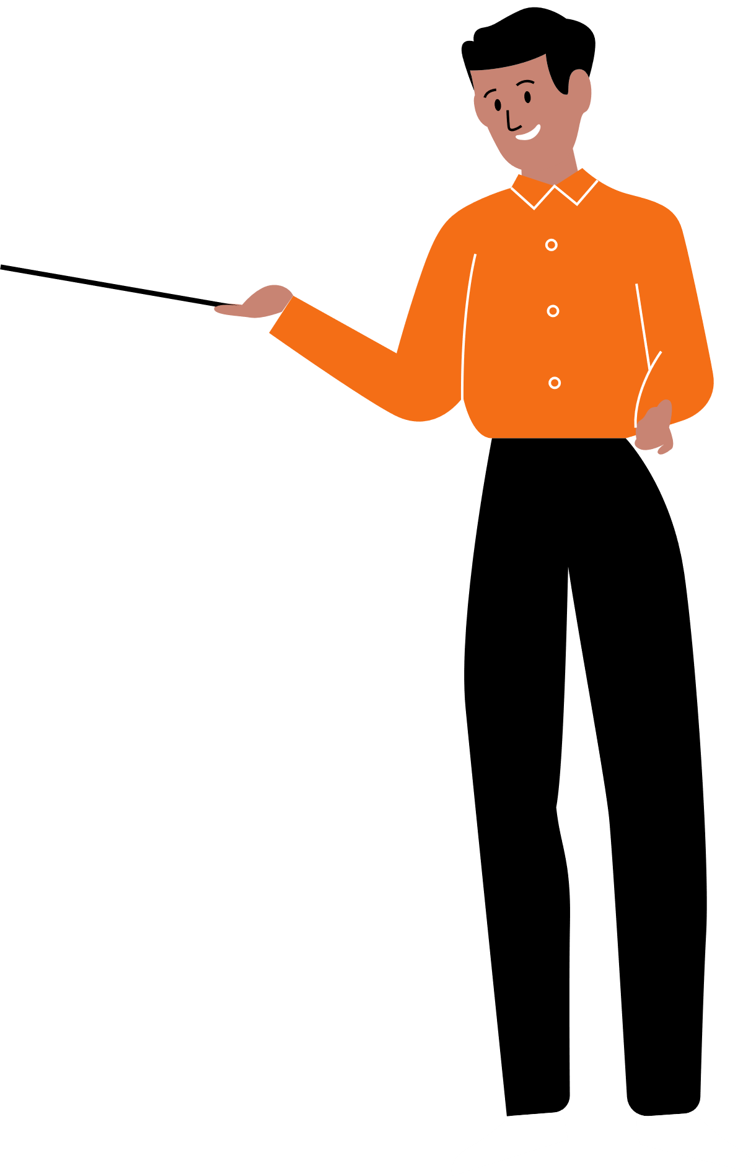


Good job!

